Slide 1
Git and Github for Beginners
Saurav Bhandari
529

Slide 2

Overview
Install git and create a Github account
What is git?
How does git work?
What is GitHub?
Quick example using git and GitHub
Github icon

Slide 3

Install git and a create GitHub account
1

Slide 4
Install git
Linux (Debian)
Command: sudo apt-get install git
Linux (Fedora)
Command: sudo yum install git
Mac
http://git-scm.com/download/mac
Windows
http://git-scm.com/download/win

Slide 5
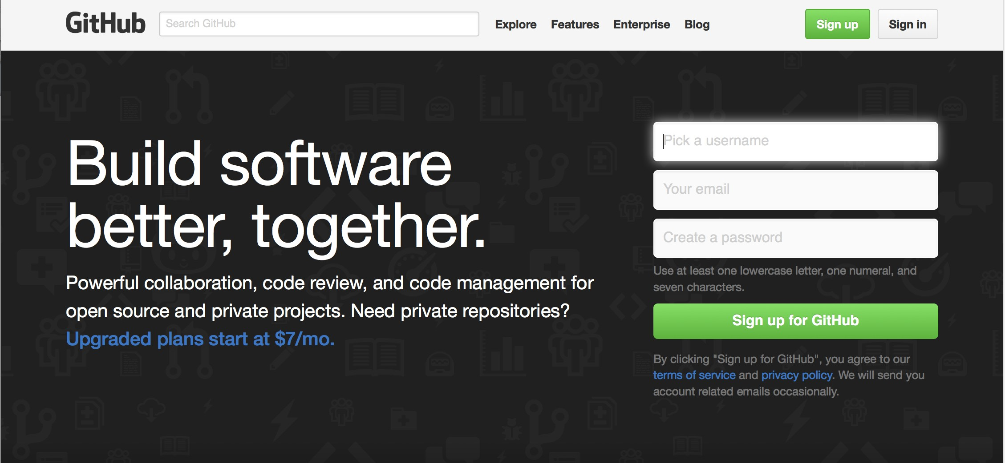
Create Github account
www.github.com
Free for public repositories

Slide 6
What is version control?
A system that keeps records of your changes
Allows for collaborative development
Allows you to know who made what changes and when
Allows you to revert any changes and go back to a previous state

Slide 7
What is git?
2

Slide 8
What is version control?
Distributed version control
Users keep entire code and history on their location machines
Users can make any changes without internet access
(Except pushing and pulling changes from a remote server)

Slide 9

What is git?
Started in 2005
Created by Linus Torvald to aid in Linux kernel development
Git icon

Slide 10



What is git?
Git isn’t the only version control system
But (we think) it’s the best

Slide 11
How does git work?
3

Slide 12
How does git work?
Can be complicated at first, but there are a few key concepts
Important git terminology in following slides are blue

Slide 13
Key Concepts: Snapshots
The way git keeps track of your code history
Essentially records what all your files look like at a given point in time
You decide when to take a snapshot, and of what files
Have the ability to go back to visit any snapshot
Your snapshots from later on will stay around, too

Slide 14
Key Concepts: Commit
The act of creating a snapshot
Can be a noun or verb
“I commited code”
“I just made a new commit”
Essentially, a project is made up of a bunch of commits

Slide 15
Key Concepts: Commit
Commits contain three pieces of information:
Information about how the files changed from previously
A reference to the commit that came before it
Called the “parent commit”
A hash code name
Will look something like:
fb2d2ec5069fc6776c80b3ad6b7cbde3cade4e

Slide 16
Key Concepts: Repositories
Often shortened to ‘repo’
A collection of all the files and the history of those files
Consists of all your commits
Place where all your hard work is stored

Slide 17
Key Concepts: Repositories
Can live on a local machine or on a remote server (GitHub!)
The act of copying a repository from a remote server is called cloning
Cloning from a remote server allows teams to work together

Slide 18
Key Concepts: Repositories
The process of downloading commits that don’t exist on your machine from a remote repository is called pulling changes
The process of adding your local changes to the remote repository is called pushing changes

Slide 19

What is GitHub?
4

Slide 20

What is GitHub?
www.github.com
Largest web-based git repository hosting service
Aka, hosts ‘remote repositories’
Allows for code collaboration with anyone online
Adds extra functionality on top of git
UI, documentation, bug tracking, feature requests, pull requests, and more!
Octocat!

Slide 21
What is GitHub?
Founded in 2008
Also has an Enterprise edition for businesses
Octocat!

Slide 22
Git Initial Setup
git config --global user.name “username"
git config --global user.email email_address

Slide 23
Pushing Local Files to GitHub
echo "# README" >> README.md
git init
git add README.md
git commit -m "first commit"
git remote add origin https://github.com/github_url.git
git push -u origin master

Slide 24


Additional Resources

Slide 25
Additional Resources
Oﬃcial git site and tutorial:
https://git-scm.com/
GitHub guides:
https://guides.github.com/
Command cheatsheet:
https://training.github.com/kit/ downloads/github-git-cheat-sheet.pdf
Interactive git tutorial:
https://try.github.io/levels/1/challenges/1
Visual/interactive cheatsheet:
http://ndpsoftware.com/git-cheatsheet.html

